Slide 1





2024 Virtual Convergence of RO and SDO Counterparts on Public and Private Schools Processes
November 20-21, 2024
@ ICT Studio

Slide 2
Opening Prayer

Slide 3
Acknowledgement of Participants

Slide 4
Day 1 Synthesis

Slide 5
Session Proper

Slide 6
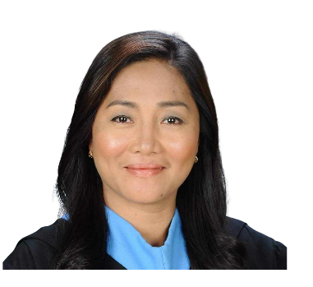

Session 8A:
Establishment of Public Schools
LOIDA G. TOMELDEN
Education Program Supervisor
Quality Assurance Division

Slide 7
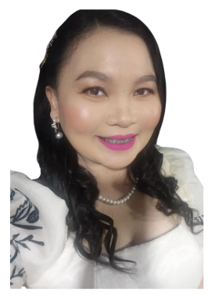
Session 8B:
Public Schools (Renaming)
EMELIA M. AYTONA
Education Program Supervisor
Quality Assurance Division

Slide 8
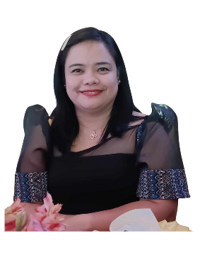
Session 8C:
Public Schools (Conversion to Integrated Schools)
ELENA L. LOPEZ
Education Program Supervisor
Quality Assurance Division

Slide 9
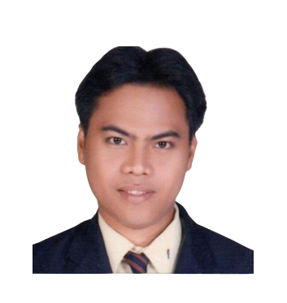
Session 8D:
Public Schools- Merging
REYMUND M. FERRY
Education Program Supervisor
Quality Assurance Division

Slide 10
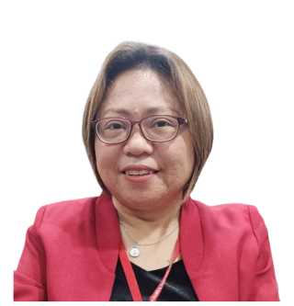
Session 8E:
Public Schools- Separation
MA. LOURDES O. MANIMTIM
Education Program Supervisor
Quality Assurance Division

Slide 11


Slide 12

Sessions shall resume at 11:00 AM

Slide 13
Session 9:
Special Order (SO) Concerns and Other Announcement
FLORENCE M. SANTOS
ADAS 1/ INCHARGE OF SO

Slide 15

Day 2
Evaluation Link

